Slide 1

Financial Well-being Evaluation Based on Multiple Metrics
University of South Florida
ISM6136: Data Mining
Kadiatou Sogodogo
Long Nguyen
Srujana Bele

Slide 2

Background on Dataset
2016 National Financial Well-Being Survey by the Consumer Financial Protection Bureau’s (CFPB)
6,394 surveys were completed.
Upon answering the questions provided, consumers were given a score from 0-100
Notes:
An essential part of the Consumer Financial Protection Bureau’s (CFPB or Bureau) mission is educating and empowering consumers to take control over their financial lives.

Slide 3

Data Preprocessing

Slide 4

Merging data
There are certain financial metrics in the survey that consists of multiple survey questions
FINKNOWL
BENEFITS
MATERIALISM
MATHARDSHIP
SELFCONTROL
Each of these questions tend to range between 1 and 5, in which 1 is the worst/most negative/lowest and 5 is the best/most positive/highest. Therefore, we calculate the mean as the overall value for these categorical variables.

Slide 5

Selecting and Renaming Variables of Interest
Continuous Variables
FINKNOWL
INCOME
BENEFITS
MATERIALISM
SELFCONTROL
MATHARDSHIP
Qualitative Variables
FINGOALS
EDUCATION
EMPLOY
MORTGAGE
HEALTH

Slide 6

Removing Invalid Data
Data points that are 99, 98, -1, -2, -3, -4, or -5 are when the survey participants refused to answer or did not have the exact answer to such questions.

Slide 7

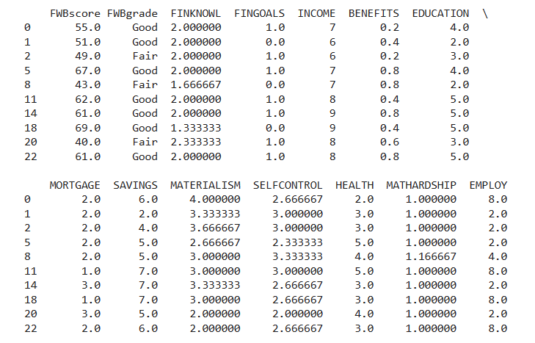
Final Dataset

Slide 8

Data Exploration

Slide 9
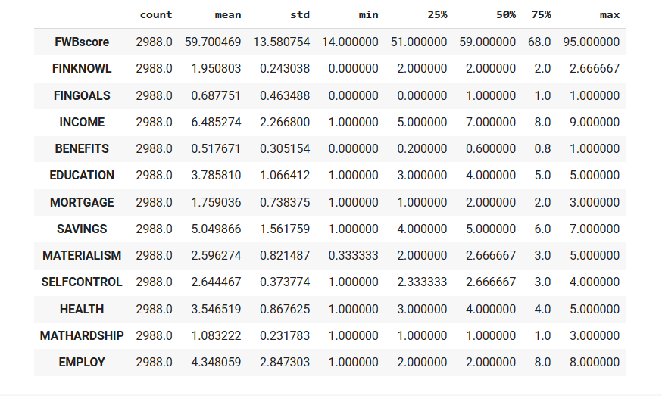
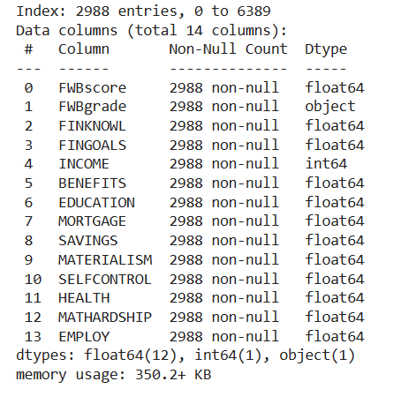
Descriptive Statistics
This is a summary of central tendency, dispersion, and shape of the distribution of a dataset

Slide 10
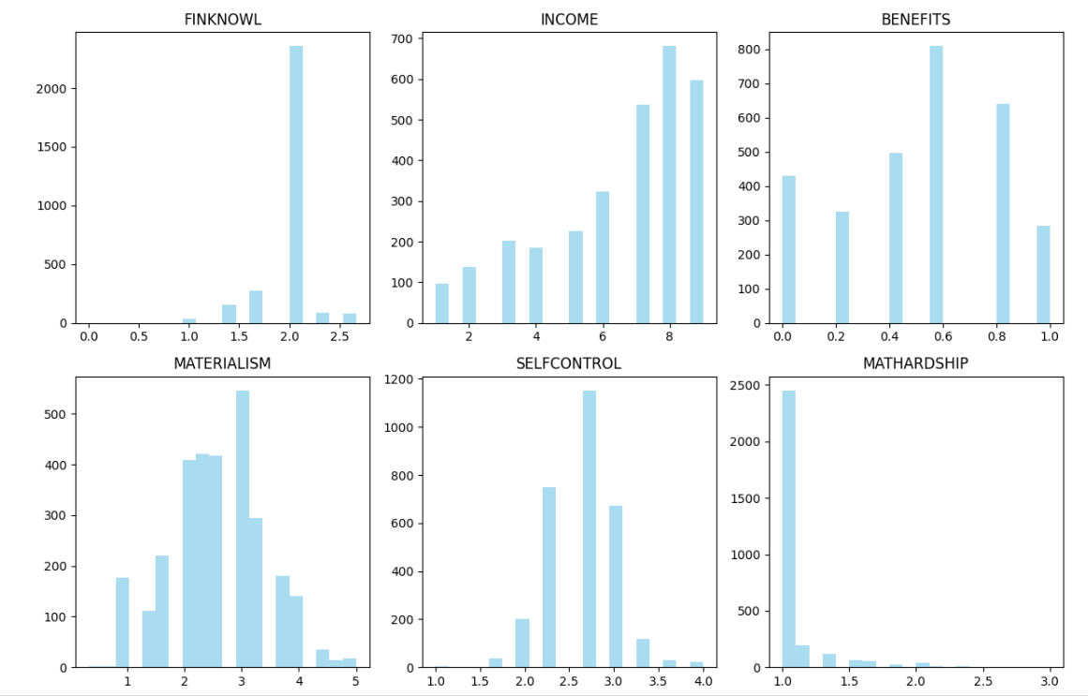
Quantitative Variables Distribution

Slide 11
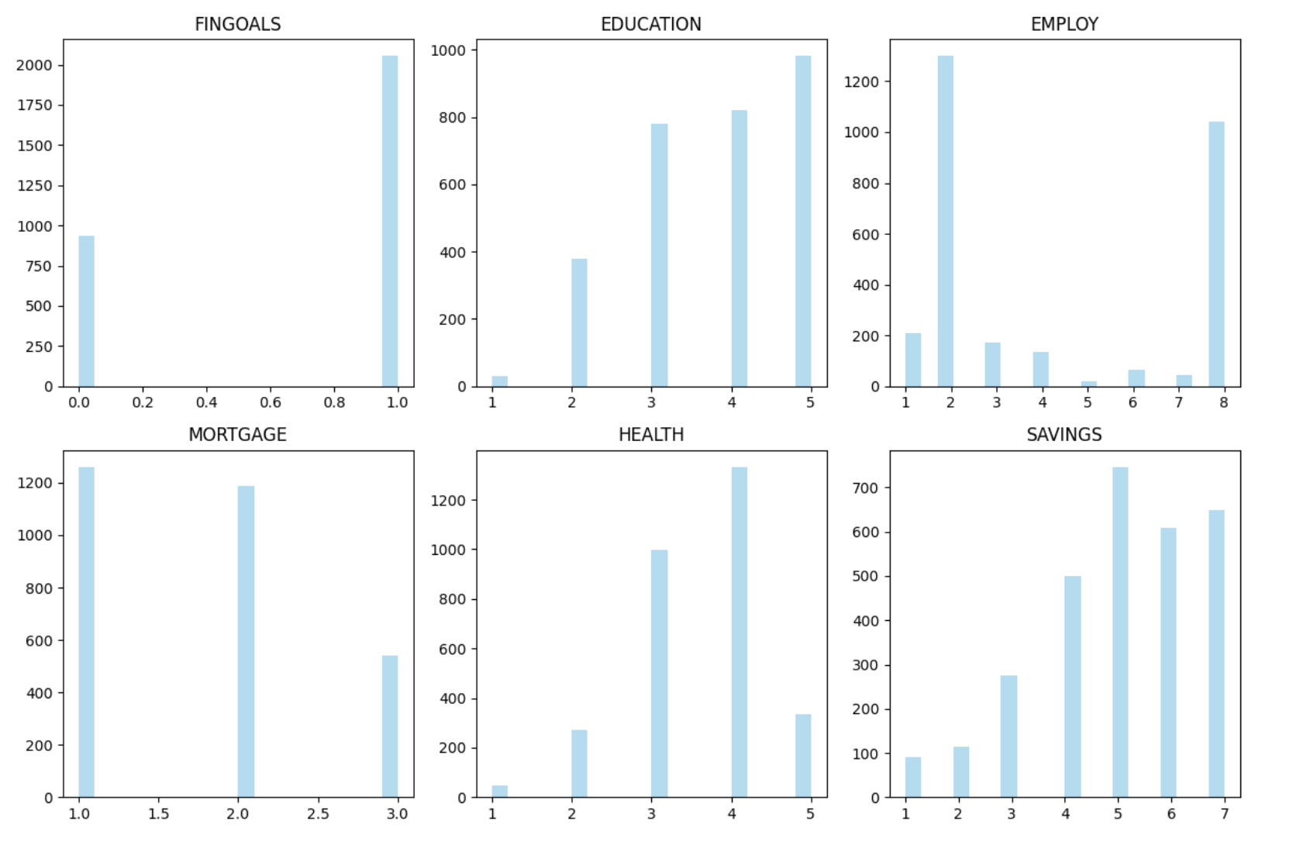
Qualitative Variables Distribution

Slide 12
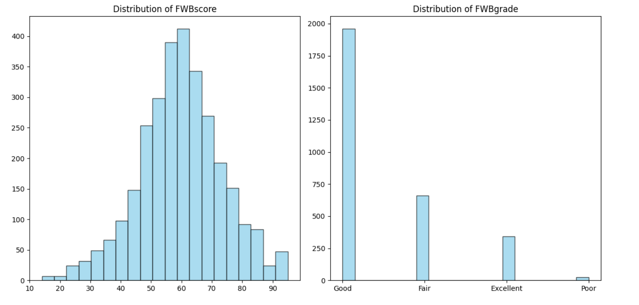
FWBscore Distribution

Slide 13
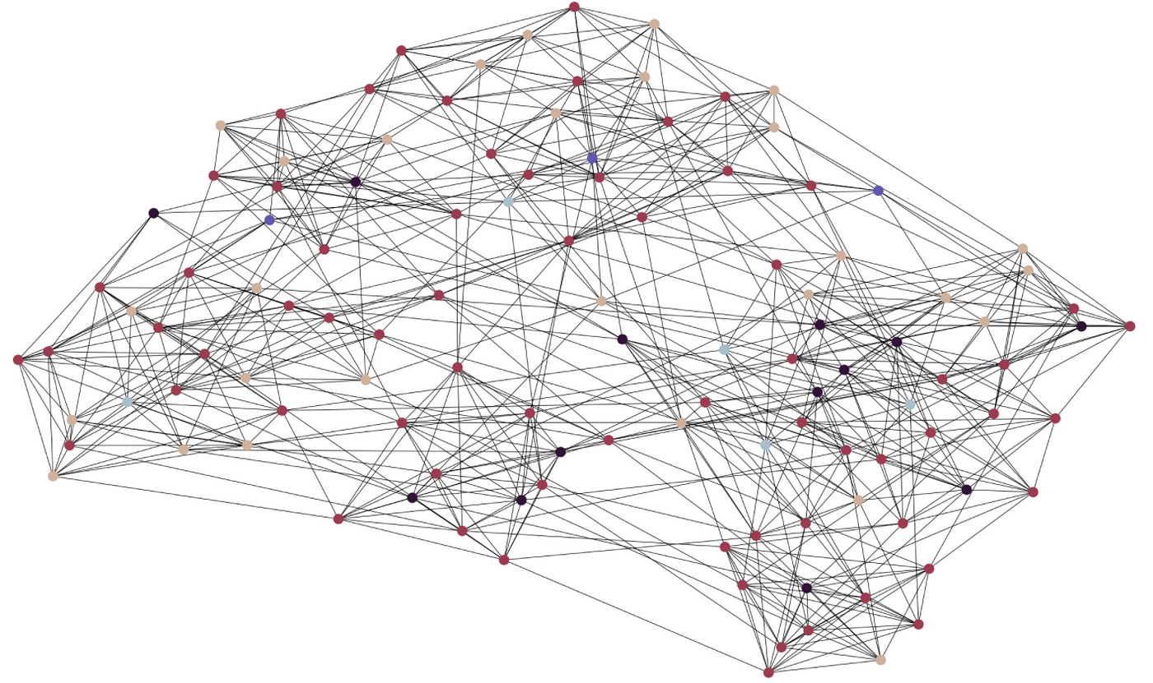
Model Building

Slide 14
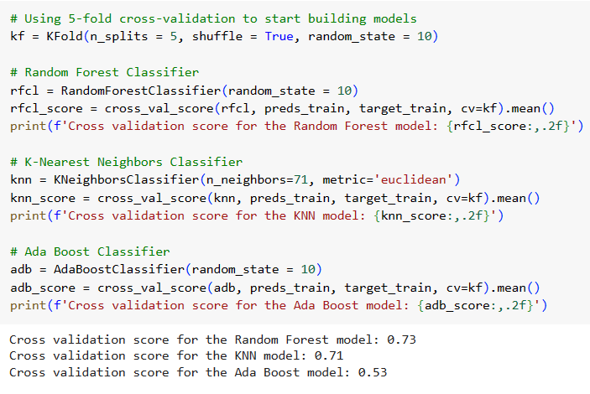
Classification Models
Target variable : FWBgrade
Predictor Variable: All variables from dataset fin_df except "FWBgrade" and "FWBscore"
We have used 70% data for training and 30% of data for testing

Slide 15
Cross-Validation
To assess the performance of machine learning models by splitting the dataset into subsets/folds for training and testing.
This process is repeated multiple times, each time using a different fold as the validation set. Finally, the results from each validation step are averaged to produce a more robust estimate of the model’s performance.
Provides a reliable estimate of model performance on unseen data
Helps detect and prevent overfitting
Focus of Today's Evaluation: K-Fold Cross-Validation
We split the dataset into k = 5 folds to evaluate the performance of three classifiers: Random Forest, K-Nearest Neighbors, and Ada Boost.

Slide 16
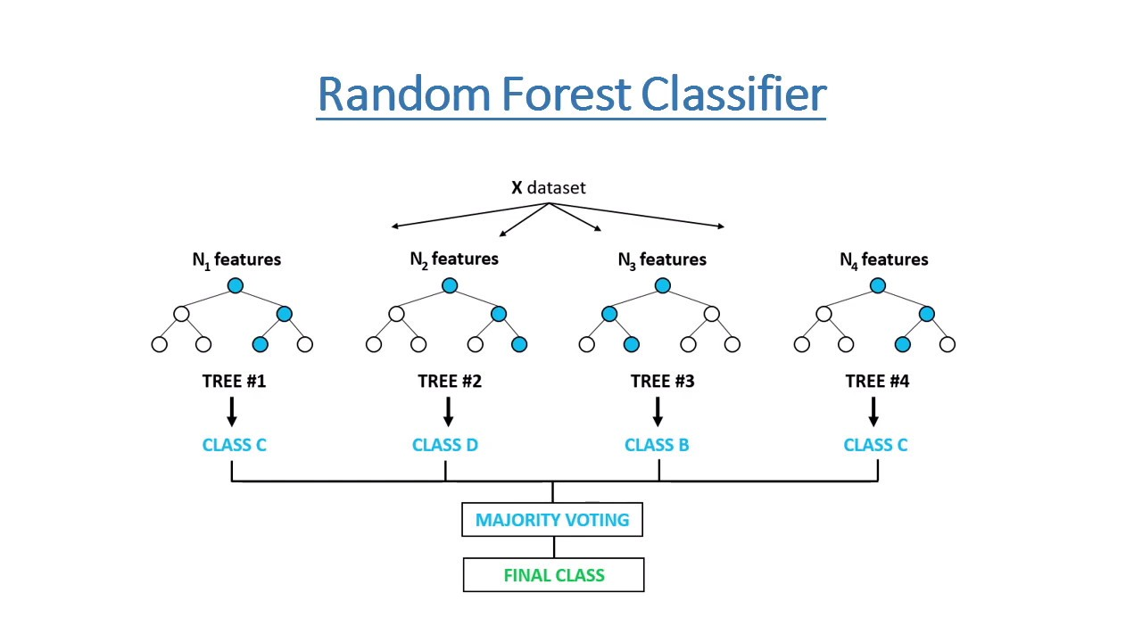
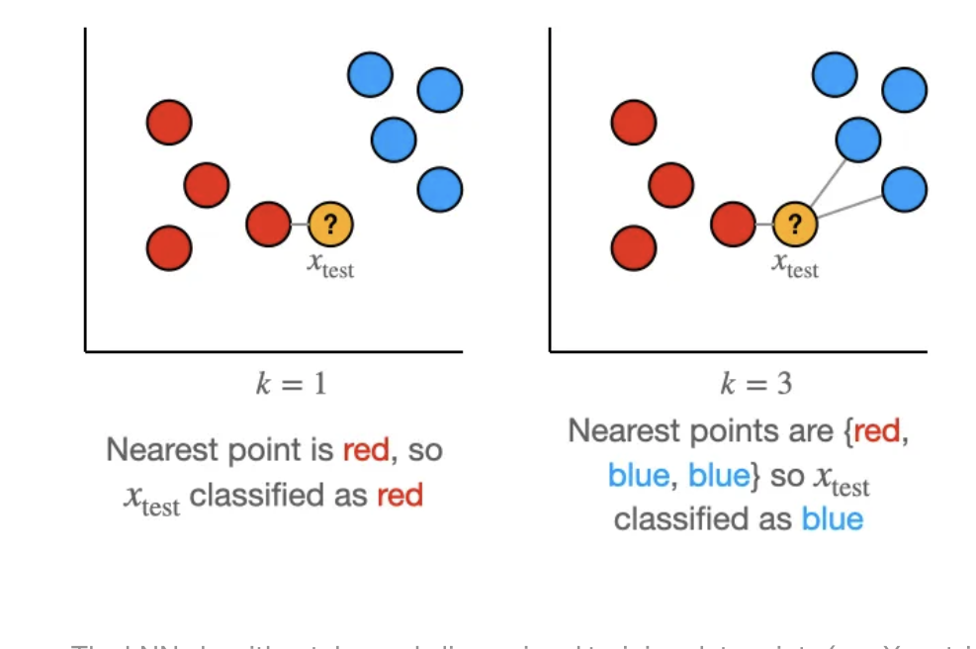
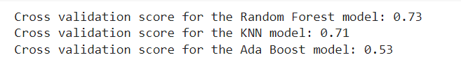
ML Models Used
We have used three classification techniques:
Random Forest Classifier
K-Nearest Neighbors (KNN) Classifier
Ada Boost Classifier

Slide 17
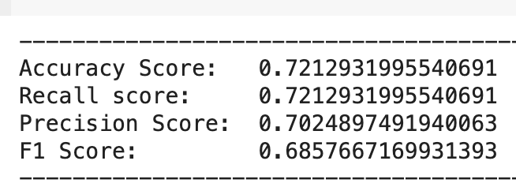
Model Performance Evaluation
Accuracy Score:
Measures the proportion of correctly predicted instances out of all instances.
Our model achieved an accuracy score of approximately 72.13%.
Recall Score:
Indicates the ability of the model to correctly identify all relevant instances.
Our model's recall score matches the accuracy score at approximately 72.13%.
Precision Score:
Measures the proportion of true positive predictions out of all positive predictions.
The precision score of our model stands at approximately 70.25%.
F1 Score:
Represents the harmonic mean of precision and recall, providing a balanced measure between the two.
Our model's F1 score is approximately 68.58%.
Before tuning the model

Slide 18
Hyperparameter Tuning
Hyperparameter involves systematically searching for the best combination of hyperparameters to maximize model performance.
Grid Search:
GridSearchCV is a powerful tool for optimizing machine learning models by systematically searching through a grid of hyperparameters and selecting the combination that yields the best performance. Used
The parameter grid specifies the hyperparameters to tune and the values to explore.

Slide 19
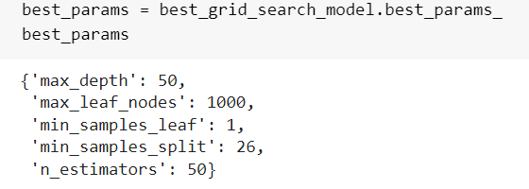
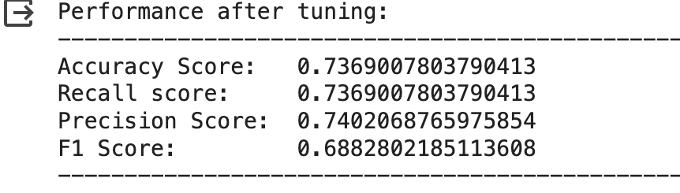
Performance Evaluation
Performance after tuning improved

Slide 20
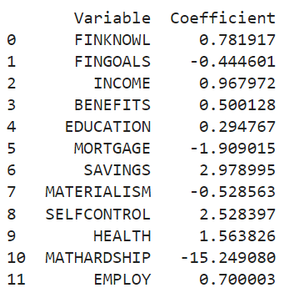
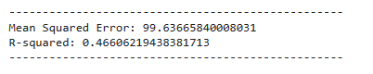
Linear Regression
Positive correlation: FINKNOWL, INCOME, BENEFITS, EDUCATION, SAVING, SELFCONTROL, HEALTH, EMPLOY
Negative correlation: FINGOALS, MORTGAGE, MATERIALISM, MATHARDSHIP
High MSE and low R-squared indicates the model's bad fit when validate with test data.
=> Not practical for predicting new data. Can we improve?

Slide 21
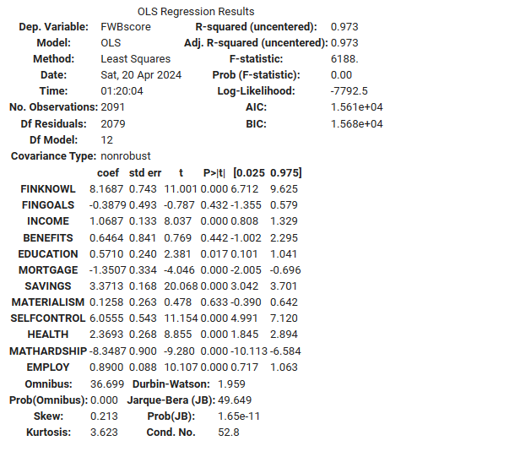
OLS Regression
Positive correlation: FINKNOWL, INCOME, BENEFITS, EDUCATION, SAVING, MATERIALISM, SELFCONTROL, HEALTH, EMPLOY
Negative correlation: FINGOALS, MORTGAGE, MATHARDSHIP
=> Similar correlation direction of predictor variables
Significant p-value, high R-squared.
=> Model works if we focus solely on explaining the relationship between the training predictor and target variables.

Slide 22
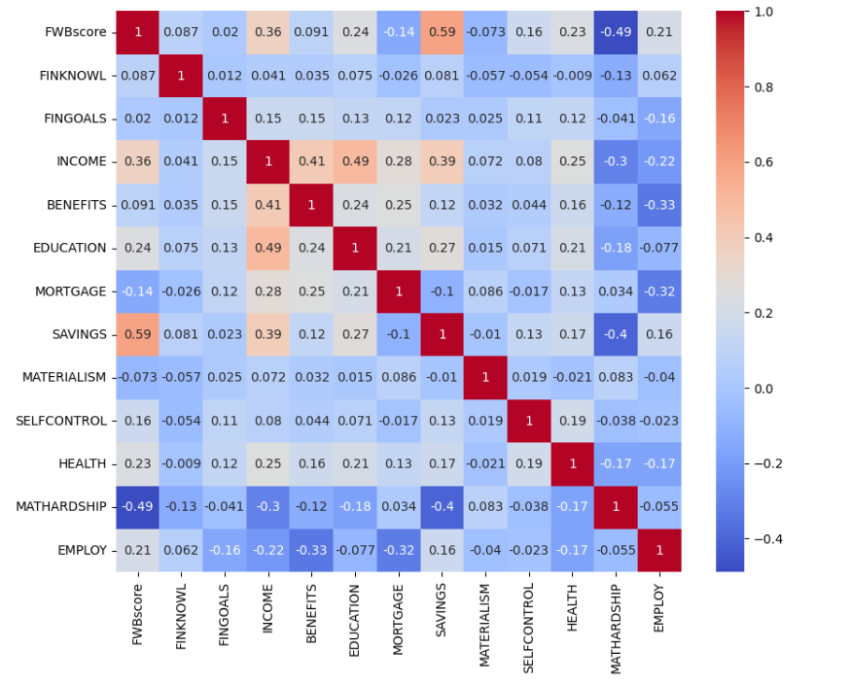
Correlation Matrix
Checking for multicolinearity and examine the correlation between FWBscore ~ variables.
Pretty low correlation across the board.
FWBscore ~ SAVINGS, MATHARDSHIP

Slide 23
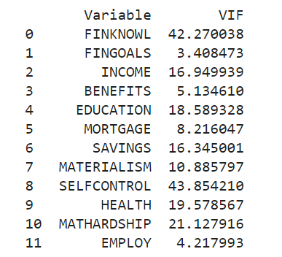
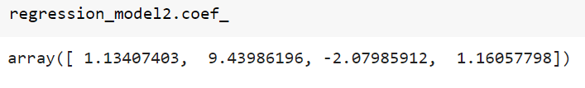
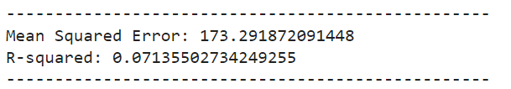
VIF
Most predictors have extreme high VIF
=> Strong relationship between predictor i and all other predictor variables, not pairwise.
Removed inflated variables and reran the regression.
Results:

Slide 24
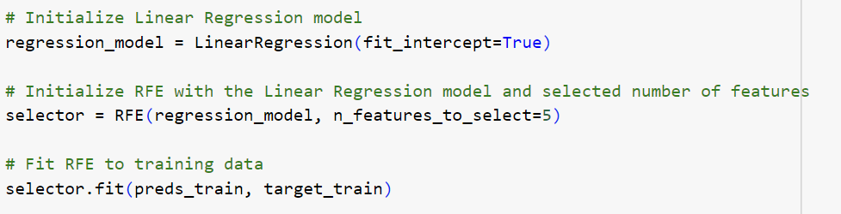
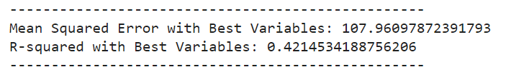
RFE
Use recursive feature elimination to select the 5 best predictor variables.
MSE and R-squared did not improve.
=> Variables are unstable and might not be suitable for predicting future FWB data.

Slide 25
Regression - Summary
Model is statistically significant and explains the relationship between predictor variables and FWBscore.
Perhaps the relationship is not exactly linear, which is why only ~47% of the data can be explained by the model.

Slide 26

THANKS FOR LISTENING

